Slide 1
Product Roadmap: Startup Validator
Now
Next
Later
Product Outcomes (Goals, e.g., OKRs)
Increase cust. satisfaction NPS +1, Referrals +20%, New Service Requests -20%
Increase Activation Rate +20% finished registrations, +35% Activation Rate
First Investors start using the product
Product Outcomes
First Resellers start using the product
Find similar ideas
Get constructive feedback
Register with a few clicks
Understand how to use the app
Customer Needs
(Customer Outcomes)
Feel encouraged
Network and build relationships
See value faster
Be notified about the required actions
Customer Needs
A/B test my startup ideas
Feel appreciated
This roadmap is an estimate only and is subject to change at any time without notice
Ⓒ Paweł Huryn

Slide 2

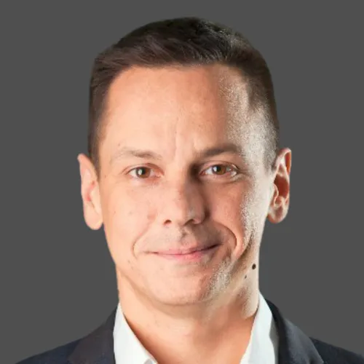
The Product Compass with Paweł
More templates:
https://www.productcompass.pm/
Join 37,000+ professionals
Get 1 actionable tip for PMs every week: https://www.productcompass.pm/
Paweł Huryn
Author, Product Coach

